Slide 1

Introduction to diffusion MRI
Anastasia Yendiki
HMS/MGH/MIT Athinoula A. Martinos Center for Biomedical Imaging

Slide 2
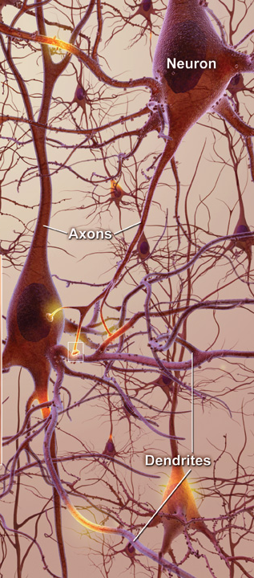
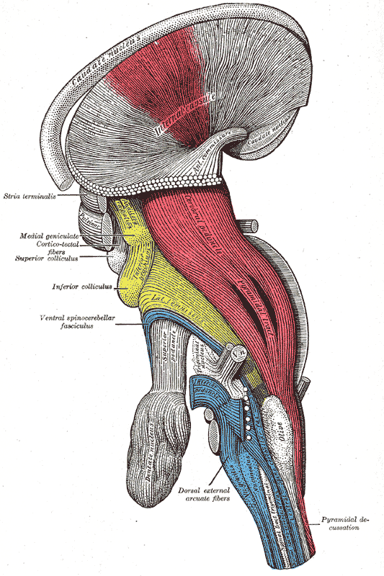
White-matter imaging
Axons measure ~μm in width
They group together in bundles that traverse the white matter
We cannot image individual axons but we can image bundles with diffusion MRI
Useful in studying neurodegenerative diseases, stroke, aging, development…
From the National Institute on Aging
From Gray's Anatomy: IX. Neurology

Slide 3
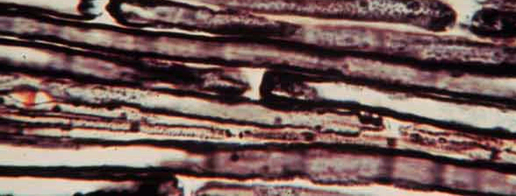
Diffusion in brain tissue
Differentiate between tissues based on the diffusion (random motion) of water molecules within them
Gray matter: Diffusion is unrestricted ⇒ isotropic
White matter: Diffusion is restricted ⇒ anisotropic

Slide 4
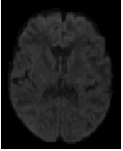
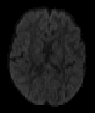
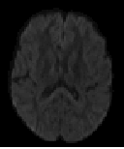
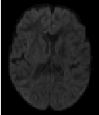
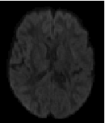
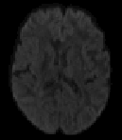
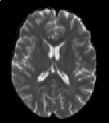
Diffusion MRI
Diffusion encoding in direction g₁
Magnetic resonance imaging can provide “diffusion encoding”
Magnetic field strength is varied by gradients in different directions
Image intensity is attenuated depending on water diffusion in each direction
Compare with baseline images to infer on diffusion process
g₂
g₃
g₄
g₅
g₆
No diffusion encoding

Slide 5
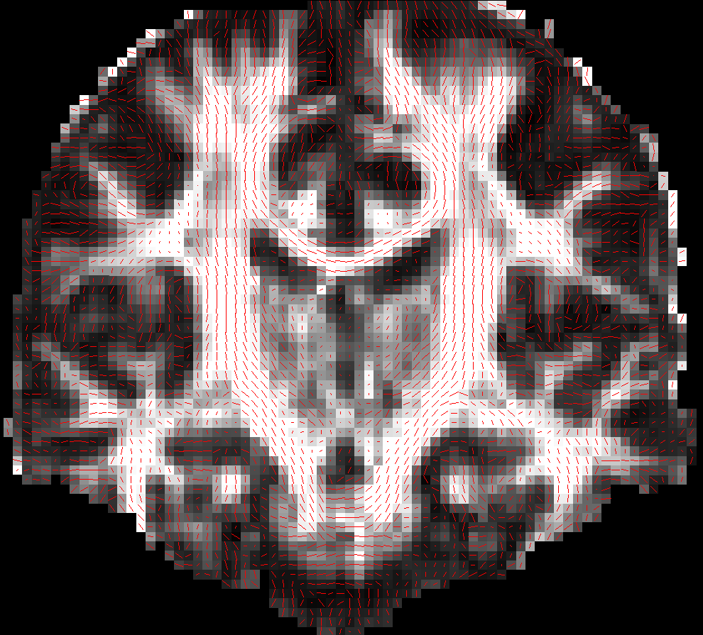
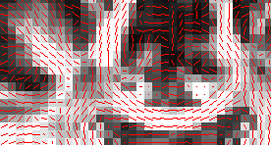
How to represent diffusion
At every voxel we want to know:
  Is this in white matter?
  If yes, what pathway(s) is it part of?
    What is the orientation of diffusion?
    What is the magnitude of diffusion?
A grayscale image cannot capture all this!

Slide 6
Tensors
One way to express the notion of direction is a tensor D
A tensor is a 3x3 symmetric, positive-definite matrix:
d₁₁ d₁₂ d₁₃
d₁₂ d₂₂ d₂₃
d₁₃ d₂₃ d₃₃
D =
D is symmetric 3x3 ⇒ It has 6 unique elements
Suffices to estimate the upper (lower) triangular part

Slide 7
Eigenvalues & eigenvectors
The matrix D is positive-definite ⇒
  It has 3 real, positive eigenvalues λ₁, λ₂, λ₃ > 0.
  It has 3 orthogonal eigenvectors e₁, e₂, e₃.
λ₁ e₁
λ₂ e₂
λ₃ e₃
D = λ₁ e₁⋅ e₁´ + λ₂ e₂⋅ e₂´ + λ₃ e₃⋅ e₃´
e_{ix}
e_{iy}
e_{iz}
e_{i} =
eigenvalue
eigenvector

Slide 8
Physical interpretation
Eigenvectors express diffusion direction
Eigenvalues express diffusion magnitude
Isotropic diffusion:
λ₁ ≈ λ₂ ≈ λ₃
  Anisotropic diffusion:
  λ₁ >> λ₂ ≈ λ₃
λ₁ e₁
λ₁ e₁
λ₂ e₂
λ₂ e₂
λ₃ e₃
λ₃ e₃
One such ellipsoid at each voxel: Likelihood of water molecule displacements at that voxel

Slide 9
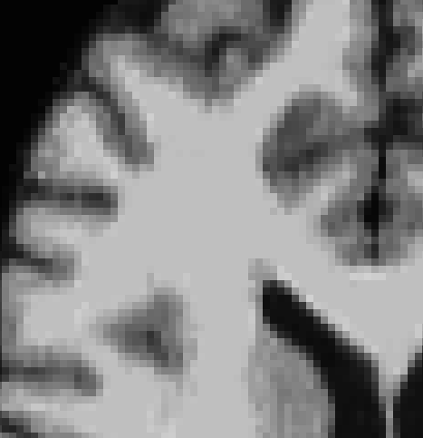
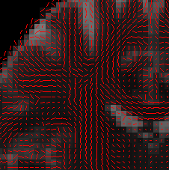
Diffusion tensor imaging (DTI)
Image:
An intensity value at each voxel
Tensor map:
A tensor at each voxel
Direction of eigenvector corresponding to greatest eigenvalue

Slide 10
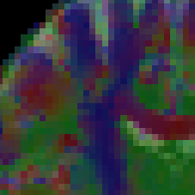
Diffusion tensor imaging (DTI)
Image:
An intensity value at each voxel
Tensor map:
A tensor at each voxel
Direction of eigenvector corresponding to greatest eigenvalue
Red: L-R, Green: A-P, Blue: I-S

Slide 11
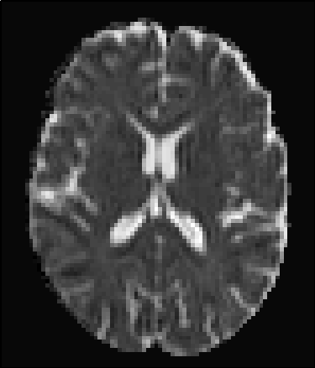
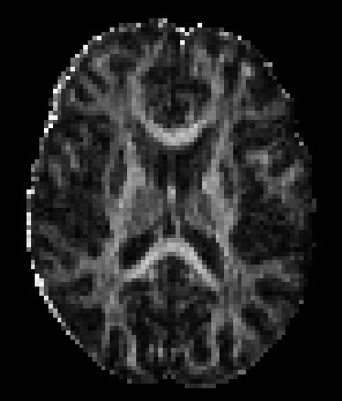
Summary measures
Faster
diffusion
Mean diffusivity (MD):
Mean of the 3 eigenvalues
Slower
diffusion
MD(j) = [λ₁(j)+λ₂(j)+λ₃(j)]/3
Anisotropic
diffusion
Fractional anisotropy (FA): Variance of the 3 eigenvalues, normalized so that 0≤ (FA) ≤1
Isotropic
diffusion
3
[λ₁(j)-MD(j)]² + [λ₂(j)-MD(j)]² + [λ₃(j)-MD(j)]²
FA(j)² =
2
λ₁(j)² + λ₂(j)² + λ₃(j)²

Slide 12
More summary measures
Axial diffusivity: Greatest of the 3 eigenvalues
Radial diffusivity: Average of 2 lesser eigenvalues
Inter-voxel coherence: Average angle b/w the major eigenvector at some voxel and the major eigenvector at the voxels around it
AD(j) = λ₁(j)
RD(j) = [λ₂(j) + λ₃(j)]/2

Slide 13
Beyond the tensor
The tensor is an imperfect model: What if more than one major diffusion direction in the same voxel?
High angular resolution diffusion imaging (HARDI): More complex models to capture more complex microarchitecture
  Mixture of tensors [Tuch’02]
  Higher-rank tensor [Frank’02, Özarslan’03]
  Ball-and-stick [Behrens’03]
  Orientation distribution function [Tuch’04]
  Diffusion spectrum [Wedeen’05]

Slide 14
Models of diffusion
Diffusion spectrum (DSI): Full distribution of orientation and magnitude
Orientation distribution function (Q-ball): No magnitude info, only orientation
Ball-and-stick: Orientation and magnitude for up to N anisotropic compartments
Tensor (DTI): Single orientation and magnitude

Slide 15
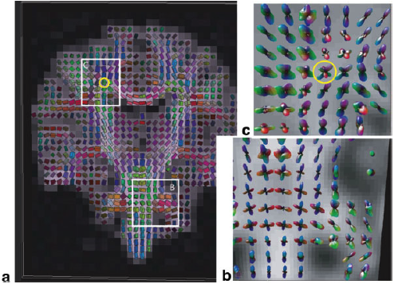
Example: DTI vs. DSI
From Wedeen et al., Mapping complex tissue architecture with diffusion spectrum magnetic resonance imaging, MRM 2005

Slide 16
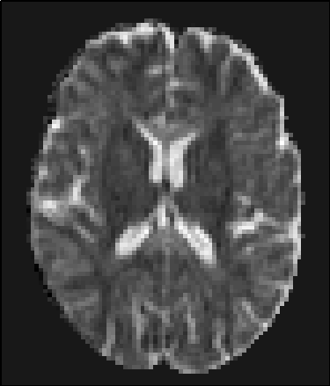
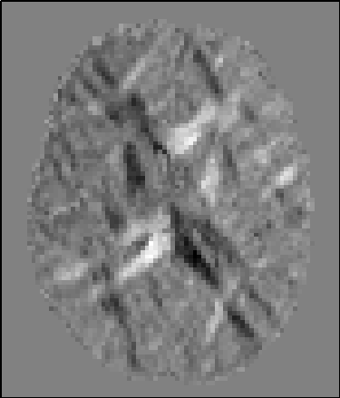
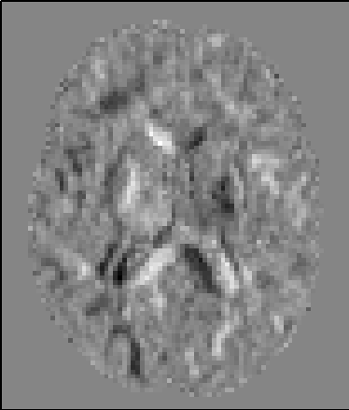
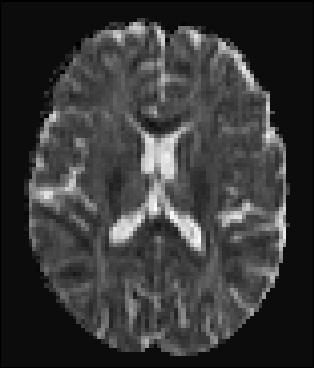
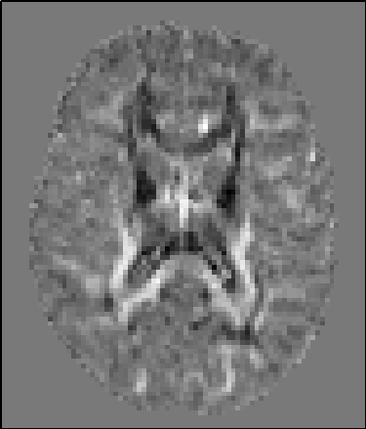
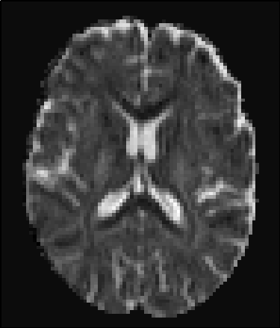
Data acquisition
d₁₁
Remember: A tensor has six unique parameters
d₁₂
d₁₃
d₁₁ d₁₂ d₁₃
d₁₂ d₂₂ d₂₃
d₁₃ d₂₃ d₃₃
D =
d₂₂
d₂₃
d₃₃
To estimate six parameters at each voxel, must acquire at least six diffusion-weighted images
HARDI models have more parameters per voxel, so more images must be acquired

Slide 17
Choice 1: Gradient directions
True diffusion direction || Applied gradient direction
⇒ Maximum attenuation
True diffusion direction ⊥ Applied gradient direction
⇒ No attenuation
To capture all diffusion directions well, gradient directions should cover 3D space uniformly
Diffusion-encoding gradient g
Displacement detected
Diffusion-encoding gradient g
Displacement not detected
Diffusion-encoding gradient g
Displacement partly detected

Slide 18
How many directions?
Acquiring data with more gradient directions leads to:
  More reliable estimation of diffusion measures
  Increased imaging time ⇒ Subject discomfort, more susceptible to artifacts due to motion, respiration, etc.
DTI:
  Six directions is the minimum
  Usually a few 10’s of directions
  Diminishing returns after a certain number [Jones, 2004]
HARDI/DSI:
  Usually a few 100’s of directions

Slide 19
Choice 2: The b-value
The b-value depends on acquisition parameters:
b = γ² G² δ² (Δ - δ/3)
  γ the gyromagnetic ratio
  G the strength of the diffusion-encoding gradient
  δ the duration of each diffusion-encoding pulse
  Δ the interval b/w diffusion-encoding pulses
90
δ
180
acquisition
G
Δ

Slide 20
How high b-value?
Increasing the b-value leads to:
  Increased contrast b/w areas of higher and lower diffusivity in principle
  Decreased signal-to-noise ratio ⇒ Less reliable estimation of diffusion measures in practice
DTI: b ~ 1000 sec/mm²
HARDI/DSI: b ~ 10,000 sec/mm²
Data can be acquired at multiple b-values for trade-off
Repeat acquisition and average to increase signal-to-noise ratio

Slide 21
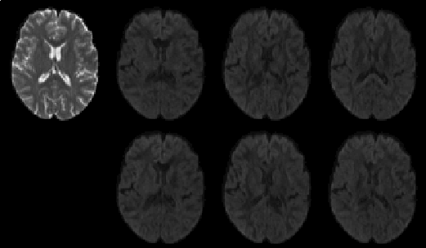
Looking at the data
A diffusion data set consists of:
A set of non-diffusion-weighted a.k.a “baseline” a.k.a. “low-b” images (b-value = 0)
A set of diffusion-weighted (DW) images acquired with different gradient directions g₁, g₂, … and b-value >0
The diffusion-weighted images have lower intensity values
b=0
b₁, g₁
b₂, g₂
b₃, g₃
Baseline
image
Diffusion-weighted
images
b₄, g₄
b₅, g₅
b₆, g₆

Slide 22
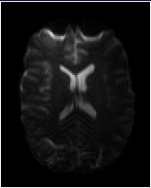
Distortions: Field inhomogeneities
Signal loss
Causes:
  Scanner-dependent (imperfections of main magnetic field)
  Subject-dependent (changes in magnetic susceptibility in tissue/air interfaces)
Results:
  Signal loss in interface areas
  Geometric distortions (warping) of the entire image

Slide 23
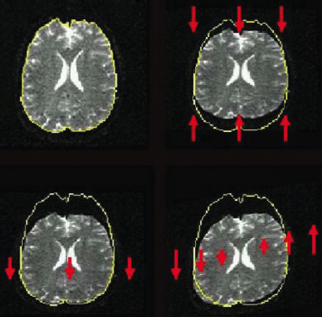
Distortions: Eddy currents
Cause: Fast switching of diffusion-encoding gradients induces eddy currents in conducting components
Eddy currents lead to residual gradients that shift the diffusion gradients
The shifts are direction-dependent, i.e., different for each DW image
Result: Geometric distortions
From Le Bihan et al., Artifacts and pitfalls in diffusion MRI, JMRI 2006

Slide 24
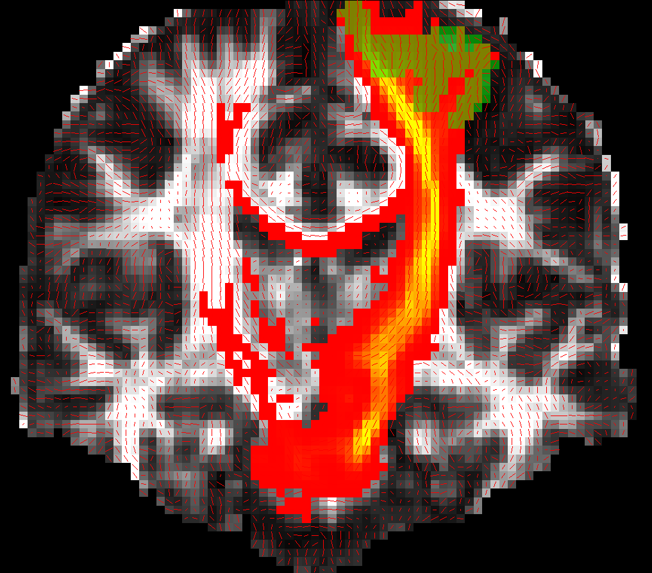
Data analysis steps
Pre-process images to reduce distortions
  Either register distorted DW images to an undistorted (non-DW) image
  Or use information on distortions from separate scans (field map, residual gradients)
Fit a diffusion model at every voxel
  DTI, DSI, Q-ball, …
Do tractography to reconstruct pathways and/or
Compute measures of anisotropy/diffusivity and compare them between populations
  Voxel-based, ROI-based, or tract-based statistical analysis

Slide 25
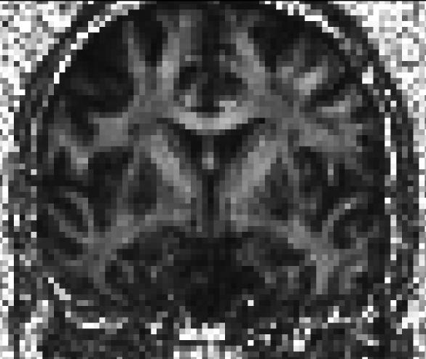
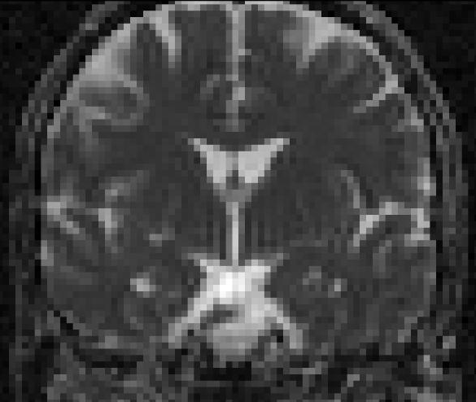
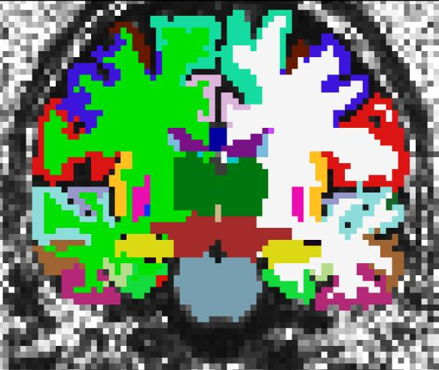
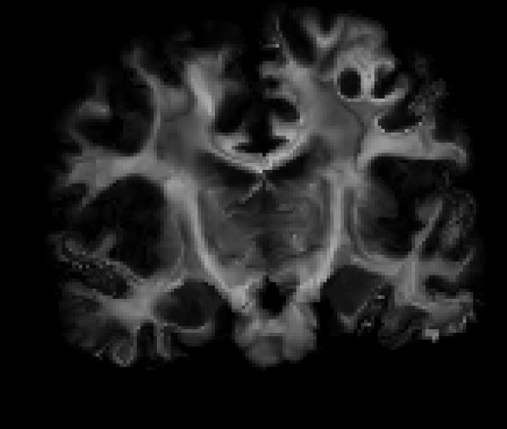
Tutorial
Use dt_recon to prepare DWI data for a simple voxel-based analysis:
  Calculate and display FA/MD/… maps
  Intra-subject registration (individual DWI to individual T1)
  Inter-subject registration (individual T1 to common template)
  Use anatomical segmentation (aparc+aseg) as a brain mask for DWIs
  Map all FA/MD/… volumes to common template to perform voxel-based group comparison

